Slide 1


Streamlit

Slide 2
Contents
Streamlit
이미지 불러오기
데이터 불러오기
자료 시각화
머신러닝과 Streamlit

Slide 3
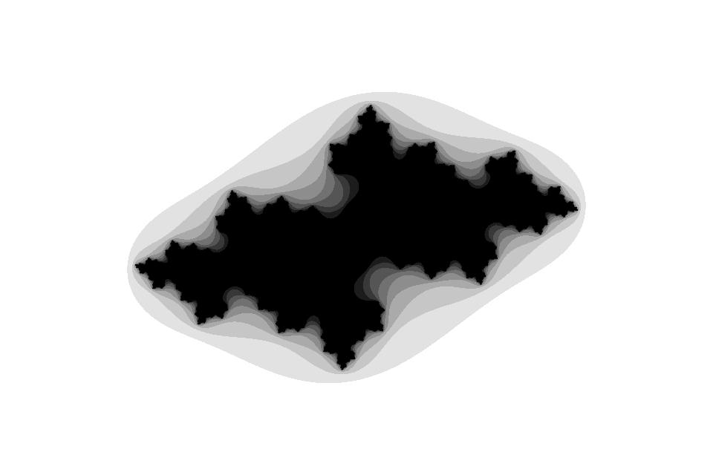
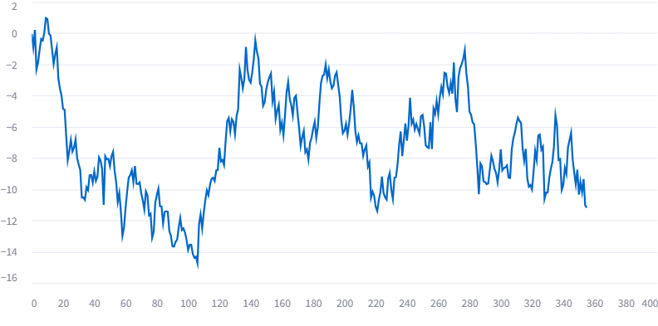
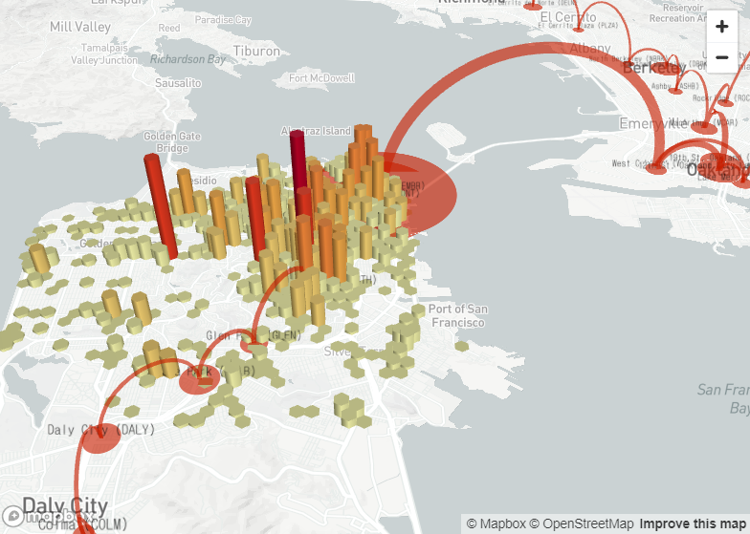
Streamlit Installation on Virtual Environment
(streamlit_venv) C:\python\streamlit>streamlit hello

Slide 4
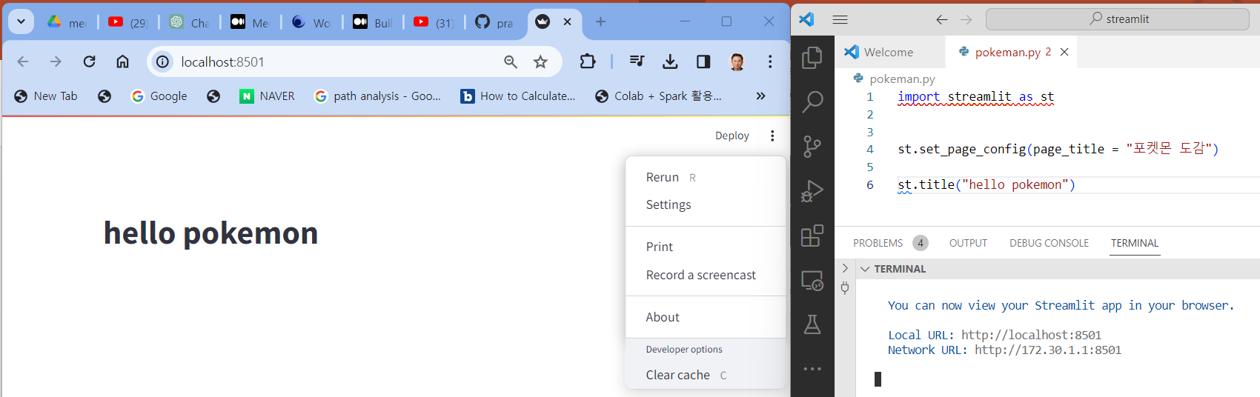
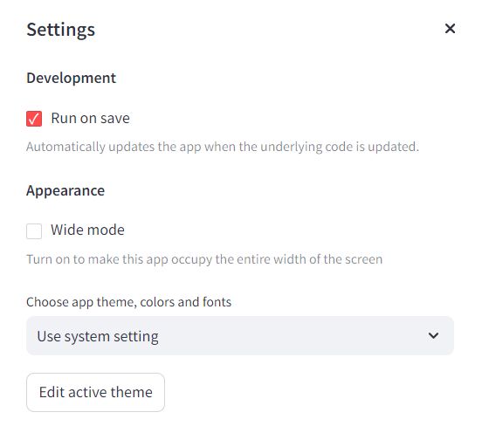
Run on save option
vs code에서 running 중인 app(*.py)을 수정하면 running중에 localhost:8501 포트의 화면이 자동으로 변경하려면

Slide 5

실습하기
https://blog.zarathu.com/posts/2023-02-01-streamlit/#streamlit-%EB%94%B0%EB%9D%BC-%ED%95%B4%EB%B3%B4%EA%B8%B0
Streamlit 따라해보기_기초

Slide 6
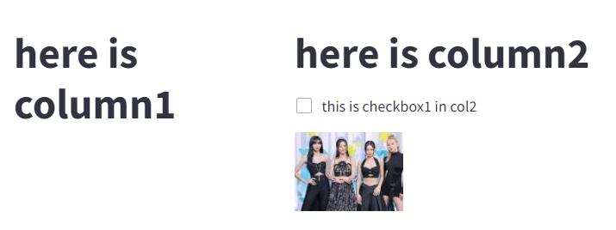
~ 2.2.3 이미지 불러오기까지 실습
import streamlit as st
from PIL import Image
# Open the JPG image
jpg_image = Image.open('bp.jpg') # Replace 'input.jpg' with the path to your JPG image # Convert the JPG image to PNG format
png_image = jpg_image.convert('RGBA')
# Save the PNG image
png_image.save('bp.png', 'PNG') # Replace 'output.png' with the desired output file name
#PIL 패키지에 이미지 모듈을 통해 이미지 열기
# Image.open('이미지 경로')
zarathu_img = Image.open('bp.png')
col1,col2 = st.columns([2,3])
with col1 :
# column 1 에 담을 내용
st.title('here is column1')
with col2 :
# column 2 에 담을 내용
st.title('here is column2')
st.checkbox('this is checkbox1 in col2 ')
# 컬럼2에 불러온 사진 표시하기
col2.image(zarathu_img)

Slide 7
실습하기
https://blog.zarathu.com/posts/2023-02-01-streamlit/#streamlit-%EB%94%B0%EB%9D%BC-%ED%95%B4%EB%B3%B4%EA%B8%B0
Streamlit 따라해보기_데이터

Slide 8
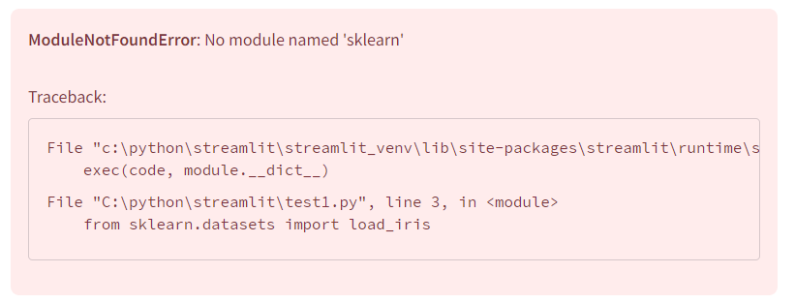
~ 2.3 데이터 불러오기까지 실습
(streamlit_venv) C:\python\streamlit>pip install sklearn
(streamlit_venv) C:\python\streamlit>pip uninstall sklearn
(streamlit_venv) C:\python\streamlit>pip install scikit-learn

Slide 9
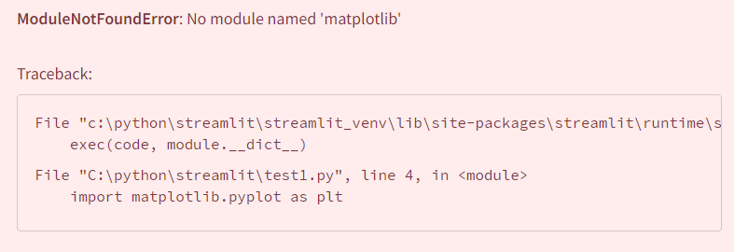
~ 2.3 데이터 불러오기까지 실습
(streamlit_venv) C:\python\streamlit>pip install matplotlib

Slide 10
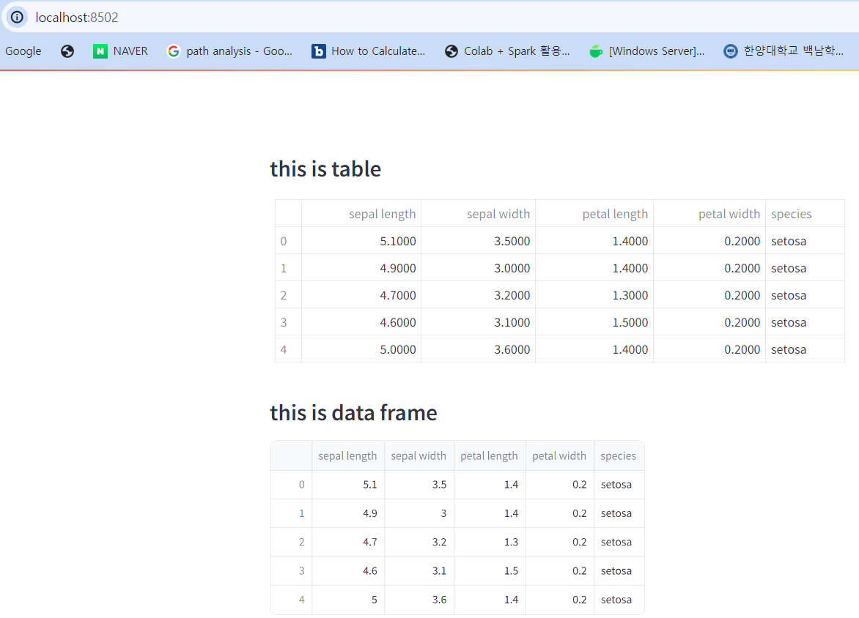
~ 2.3 데이터 불러오기까지 실습
import numpy as np
import pandas as pd
from sklearn.datasets import load_iris
import matplotlib.pyplot as plt
import streamlit as st
iris_dataset = load_iris()
df= pd.DataFrame(data=iris_dataset.data,columns= iris_dataset.feature_names)
df.columns= [ col_name.split(' (cm)')[0] for col_name in df.columns]
df['species']= iris_dataset.target
species_dict = {0 :'setosa', 1 :'versicolor', 2 :'virginica'}
def mapp_species(x):
return species_dict[x]
df['species'] = df['species'].apply(mapp_species)
print(df)
st.subheader('this is table')
st.table(df.head())
st.subheader('this is data frame')
st.dataframe(df.head())

Slide 11
실습하기
https://blog.zarathu.com/posts/2023-02-01-streamlit/#streamlit-%EB%94%B0%EB%9D%BC-%ED%95%B4%EB%B3%B4%EA%B8%B0
Streamlit 따라해보기_시각화

Slide 12
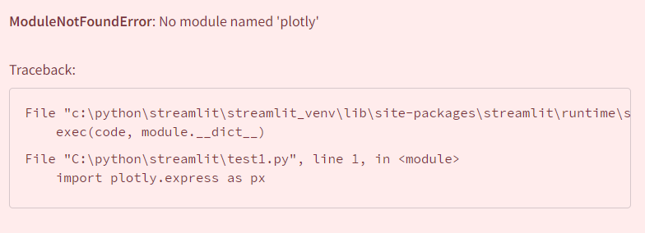
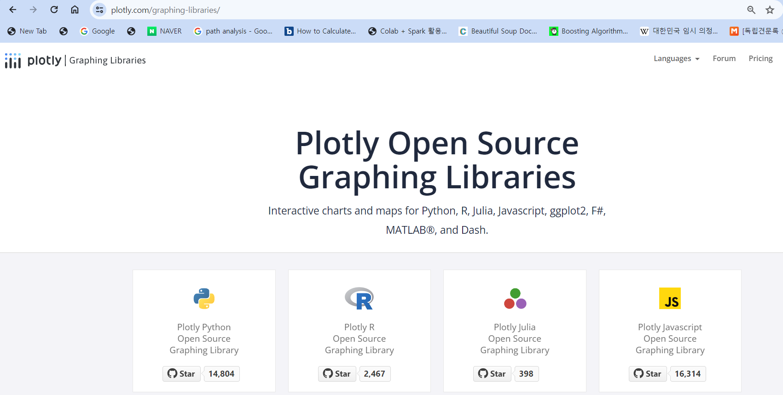
~ 3.2 시각화까지 실습
(streamlit_venv) C:\python\streamlit>pip install plotly==5.18.0

Slide 13
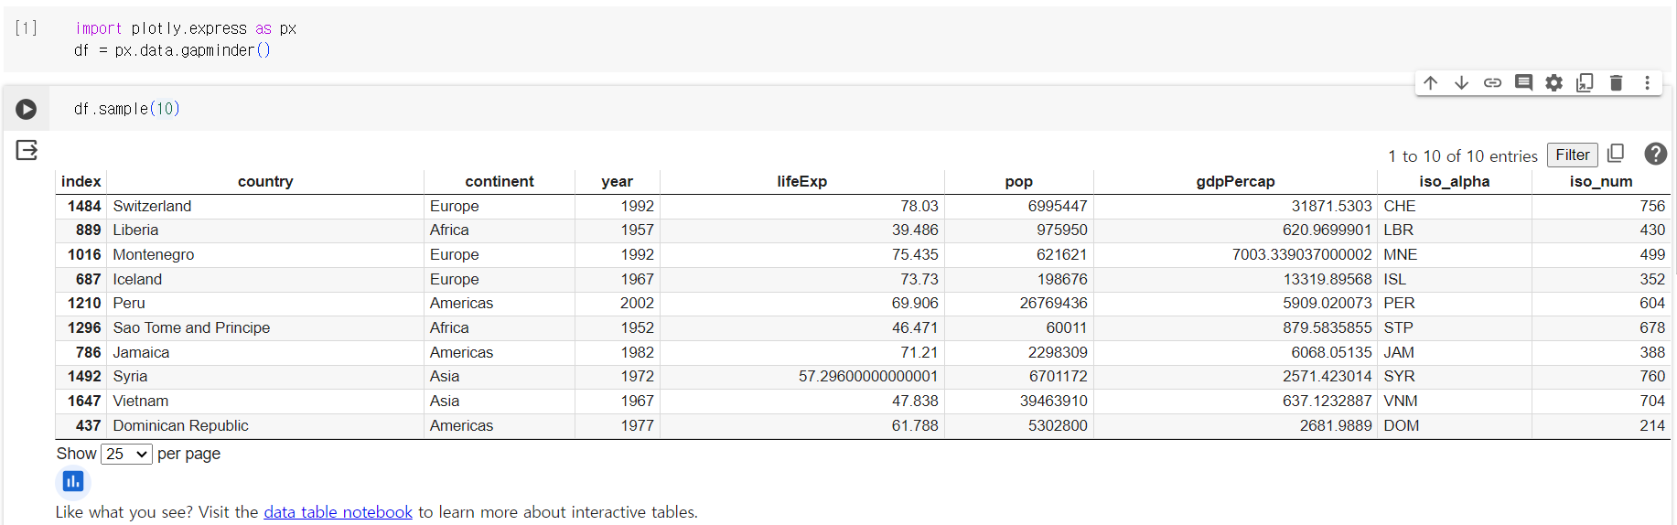
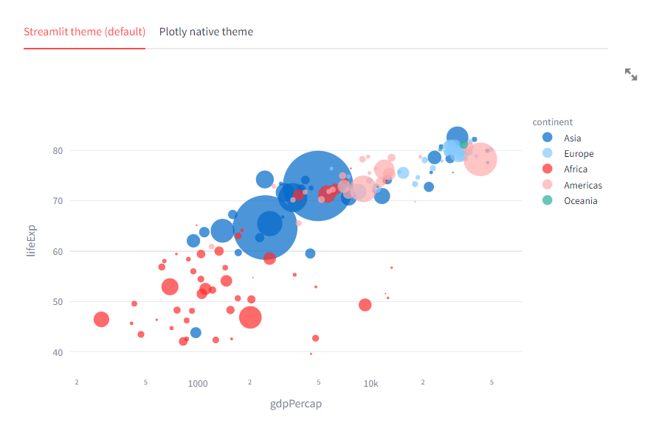
~ 3.2 시각화까지 실습
import plotly.express as px
import streamlit as st
df = px.data.gapminder()
fig = px.scatter(
df.query("year==2007"),
x="gdpPercap",
y="lifeExp",
size="pop",
color="continent",
hover_name="country",
log_x=True,
size_max=60,
)
fig.show()
tab1, tab2 = st.tabs(["Streamlit theme (default)", "Plotly native theme"])
with tab1:
# Use the Streamlit theme.
# This is the default. So you can also omit the theme argument.
st.plotly_chart(fig, theme="streamlit", use_container_width=True)
with tab2:
# Use the native Plotly theme.
st.plotly_chart(fig, theme=None, use_container_width=True)

Slide 14
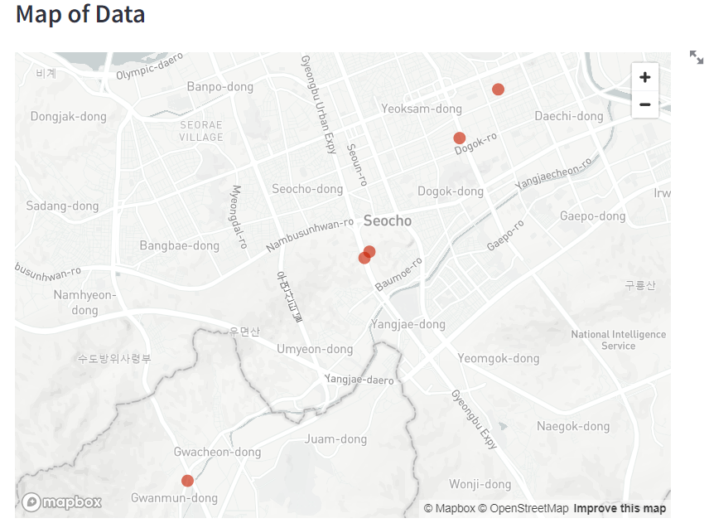
~ 3.2 시각화까지 실습
import numpy as np
import pandas as pd
import streamlit as st
#지도 위에 표시될 점 좌표 값을 위도경도에 담습니다 .
base_position = [37.5073423, 127.0572734]
#중심점의 위도, 경도 좌표를 리스트에 담습니다.
# base_position에, 랜덤으로 생성한 값을 더하여 5개의 좌표를 데이터 프레임으로 생성하였고,
# 컬럼명은 위도 :lat 경도 lon으로 지정하였습니다.
map_data = pd.DataFrame(
np.random.randn(5, 1) / [20, 20] + base_position ,
columns=['lat', 'lon'])
# map data 생성 : 위치와 경도
print(map_data)
st.code('st.map(map_data)')
# 웹사이트에 어떤 코드인지 표시해주기
st.subheader('Map of Data ')
# 제목 생성
st.map(map_data)
# 지도 생성

Slide 15
실습하기
https://blog.zarathu.com/posts/2023-02-01-streamlit/#streamlit-%EB%94%B0%EB%9D%BC-%ED%95%B4%EB%B3%B4%EA%B8%B0
matplotlob, seaborn_시각화

Slide 16
Matplotlib

Slide 17
Seaborn

Slide 18
실습하기
Streamlit_Documentation

Slide 19
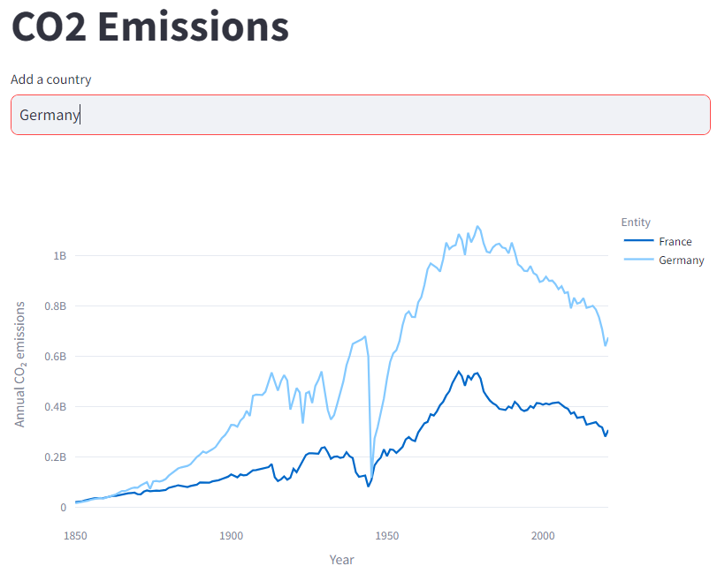
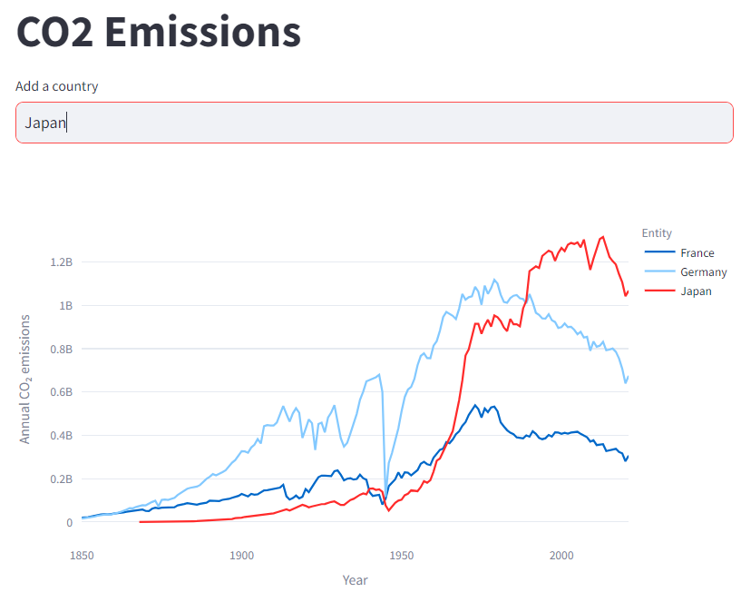
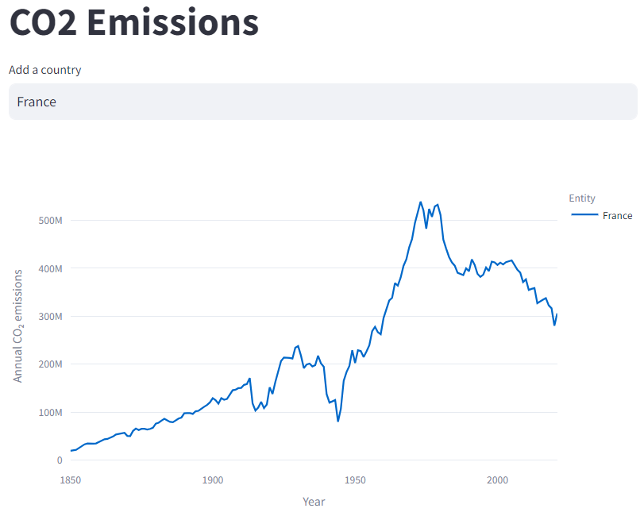
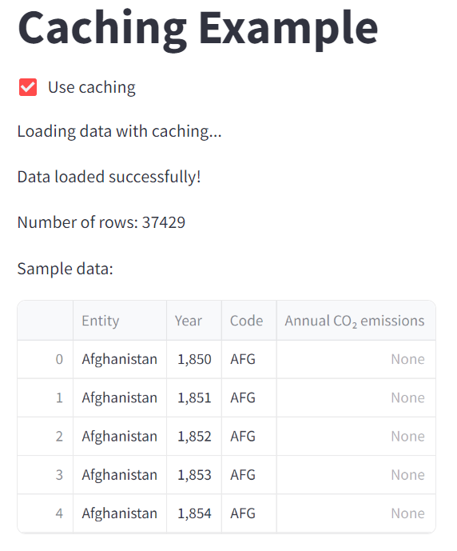
session_state & caching

Slide 20
실습하기
Streamlit_Documentation

Slide 21
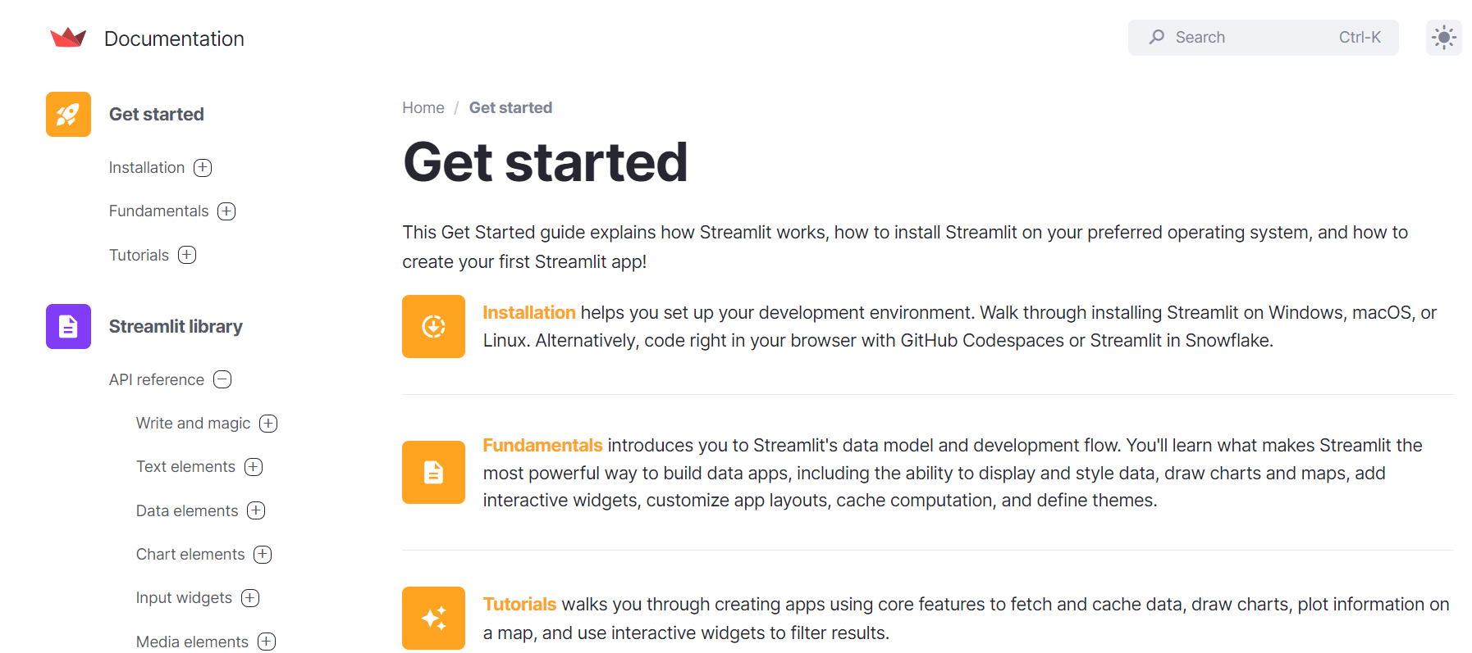
https://docs.streamlit.io/get-started

Slide 22

Project_pocket monster

Slide 23
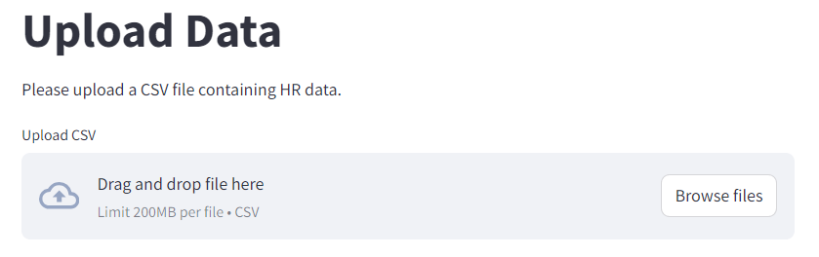
ML Practice_obtain data
import streamlit as st
import pandas as pd
from sklearn import datasets
import matplotlib.pyplot as plt
from sklearn import datasets
def upload_hr_data():
st.title("Upload Data")
st.write("Please upload a CSV file containing HR data.")
# File upload section
uploaded_file = st.file_uploader("Upload CSV", type="csv")
if uploaded_file is not None:
# Read the uploaded file
df = pd.read_csv(uploaded_file)
# Display the uploaded data
st.write("Uploaded HR Data:")
st.dataframe(df)
# Streamlit UI code
def main():
# Upload external file
upload_hr_data()
if __name__ == "__main__":
main()

Slide 24
ML Practice_plot data
import streamlit as st
import pandas as pd
from sklearn import datasets
import matplotlib.pyplot as plt
from sklearn import datasets
def upload_hr_data():
st.title("Upload Data")
st.write("Please upload a CSV file containing HR data.")
# File upload section
uploaded_file = st.file_uploader("Upload CSV", type="csv")
if uploaded_file is not None:
# Read the uploaded file
df = pd.read_csv(uploaded_file)
# Display the uploaded data
st.write("Uploaded HR Data:")
st.dataframe(df)
# Define a function to create the scatter plotdef create_scatter_plot():
st.title("Iris Dataset Scatter Plot")
st.write("This app displays a scatter plot of the Iris dataset.")
# Load the Iris dataset
iris = datasets.load_iris() # Create the scatter plot
_, ax = plt.subplots()
scatter = ax.scatter(iris.data[:, 0], iris.data[:, 1], c=iris.target)
ax.set(xlabel=iris.feature_names[0], ylabel=iris.feature_names[1])
_ = ax.legend(
scatter.legend_elements()[0], iris.target_names, loc="lower right", title="Classes"
) return plt.gcf()
# Streamlit UI code
def main():
# Create the scatter plot using the user-defined function
scatter_plot = create_scatter_plot()
# Display the plot in Streamlit
st.pyplot(scatter_plot)
# Upload external file
upload_hr_data() if __name__ == "__main__":
main()

Slide 25
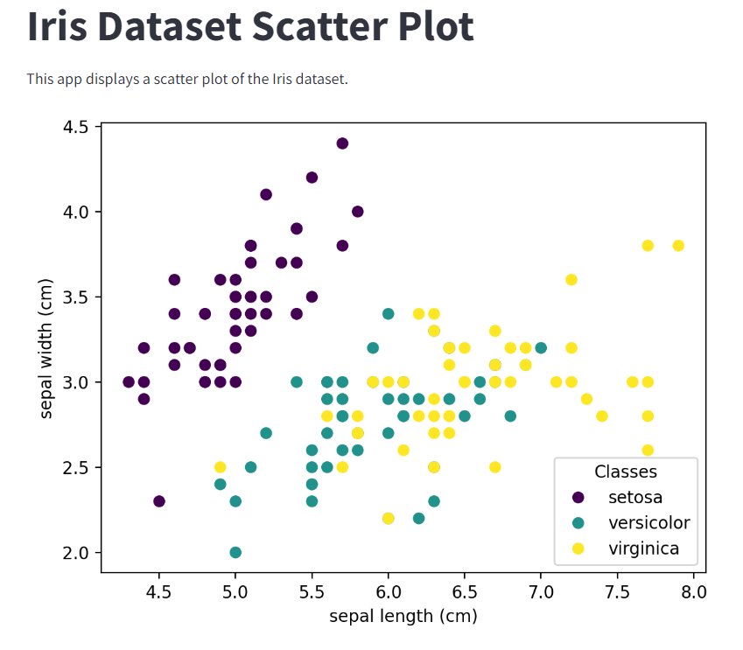
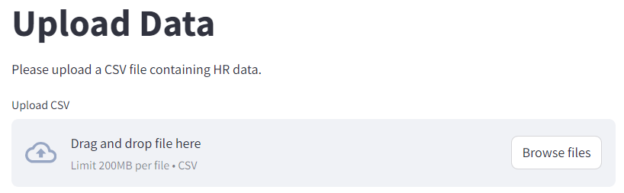
Machine Learning Practice
# https://scikit-learn.org/stable/auto_examples/datasets/plot_iris_dataset.html → chatgpt

Slide 26
ML Practice_scaling data(Preprocessing)
from sklearn.preprocessing import StandardScaler
# Define a function to apply StandardScaler to the dataset
def apply_standard_scaler():
# Load the Iris dataset
iris = datasets.load_iris()
# Apply StandardScaler to the dataset
scaler = StandardScaler()
iris_scaled = scaler.fit_transform(iris.data)
# Create a DataFrame with the scaled data
iris_scaled_df = pd.DataFrame(data=iris_scaled, columns=iris.feature_names)
return iris_scaled_df
# Streamlit UI code
def main():
st.title("Iris Dataset Analysis")
st.write("This app displays a scatter plot of the Iris dataset.")
# Create the scatter plot using the user-defined function
scatter_plot = create_scatter_plot()
# Display the scatter plot in Streamlit
st.pyplot(scatter_plot)
# Apply StandardScaler and display the scaled data as a DataFrame
st.subheader("Scaled Iris Dataset")
iris_scaled_df = apply_standard_scaler()
st.write("Scaled Iris Data:")
st.dataframe(iris_scaled_df)
# Upload external file
upload_hr_data()
if __name__ == "__main__":
main()

Slide 27
ML Practice_ML modeling
import pandas as pd
from sklearn.model_selection import train_test_split
from sklearn.neighbors import KNeighborsClassifier
from sklearn.metrics import accuracy_score, classification_report
# Define a function to perform KNN classification
def knn_classification(X, y):
# Load the Iris dataset
iris = datasets.load_iris()
# Split the data into training and testing sets
X_train, X_test, y_train, y_test = train_test_split(X, y, test_size=0.2,
random_state=42) # Create a KNN classifier
knn_classifier = KNeighborsClassifier(n_neighbors=3)
# Train the classifier
knn_classifier.fit(X_train, y_train)
# Make predictions on the test set
y_pred = knn_classifier.predict(X_test)
# Calculate accuracy
accuracy = accuracy_score(y_test, y_pred)
# Generate classification report
report = classification_report(y_test, y_pred, target_names=iris.target_names)
return accuracy, report
# Streamlit UI code
def main():
st.title("Iris Dataset Analysis and KNN Classification")
st.write("This app displays a scatter plot of the Iris dataset, the scaled data using StandardScaler, and performs KNN classification.")
# Create the scatter plot using the user-defined function
scatter_plot = create_scatter_plot()
# Display the scatter plot in Streamlit
st.pyplot(scatter_plot)
# Apply StandardScaler and display the scaled data as a DataFrame
st.subheader("Scaled Iris Dataset")
iris_scaled_df = apply_standard_scaler()
st.write("Scaled Iris Data:")
st.dataframe(iris_scaled_df)
# Perform KNN classification
st.subheader("KNN Classification Results")
X = iris_scaled_df.values # Features
y = datasets.load_iris().target # Target variable accuracy, report = knn_classification(X, y)
# Display the results
st.write(f"Accuracy: {accuracy}")
st.write("Classification Report:")
st.text(report)
if __name__ == "__main__":
main()

Slide 28
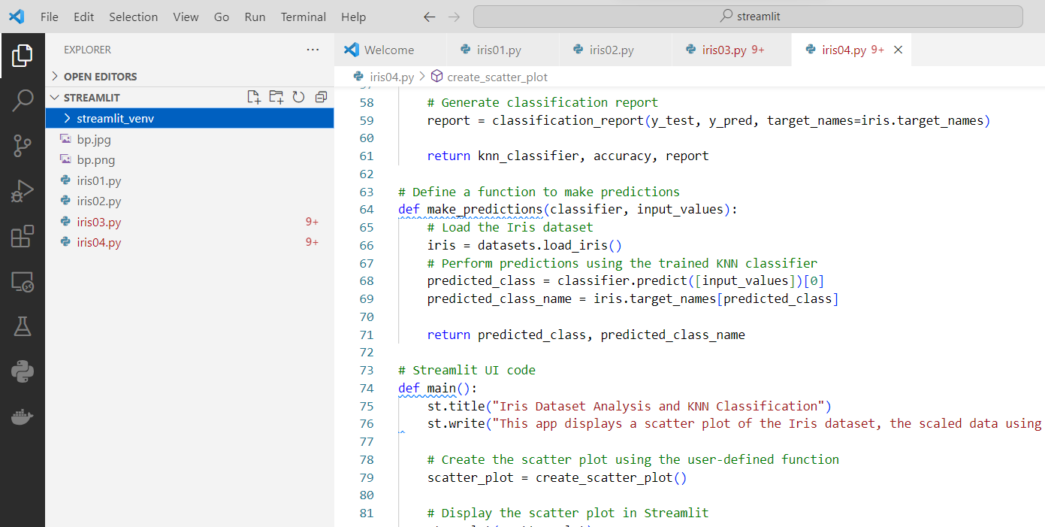
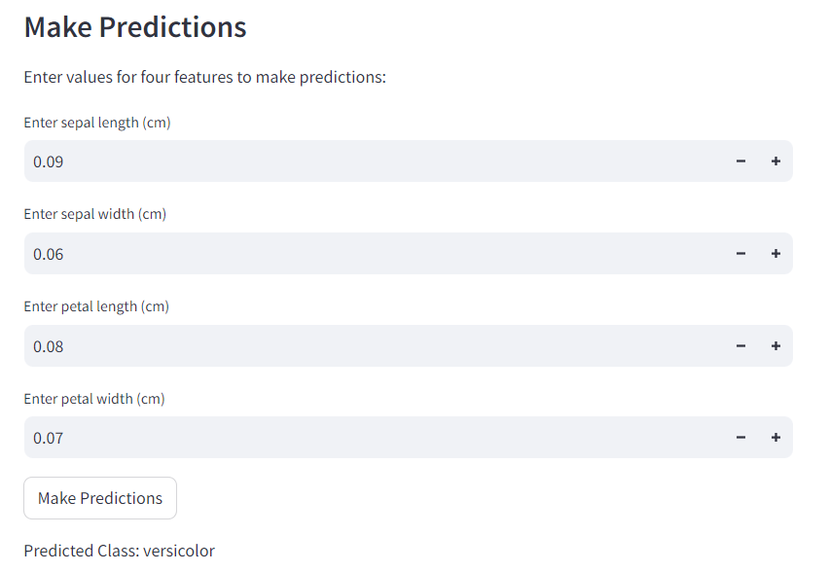
ML Practice_ML predicting

